Slide 1
Liam Saunders L00187849 Vlan Diagram Logical Diagram of Site and Buildings Logical Diagram of Forecourt building

Slide 2
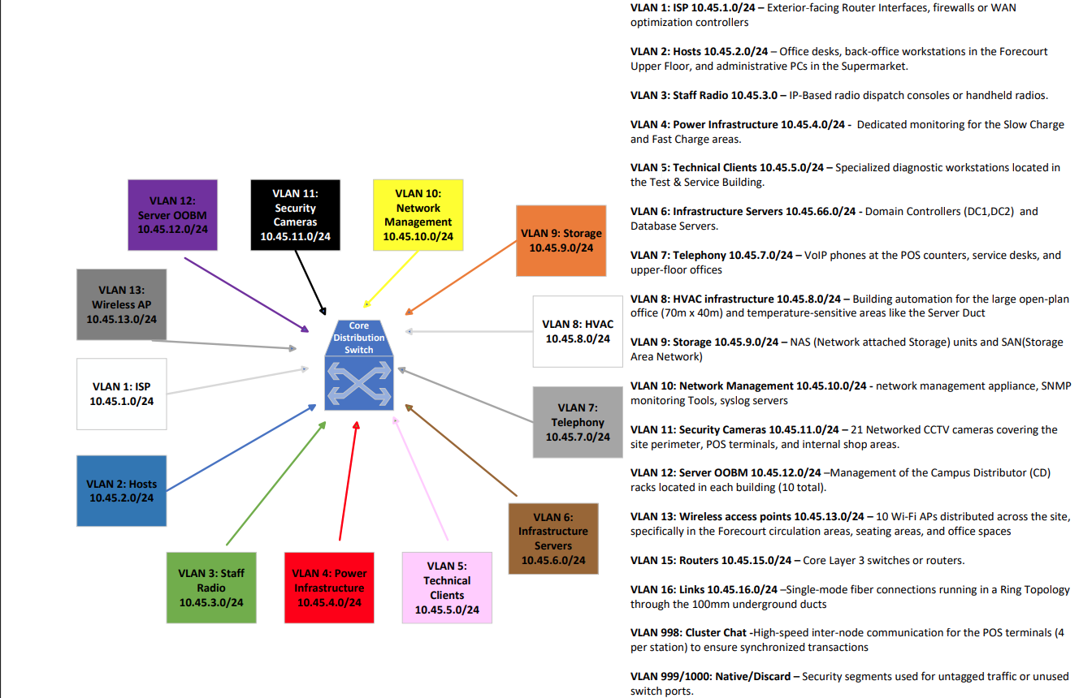
VLAN Diagram

Slide 3
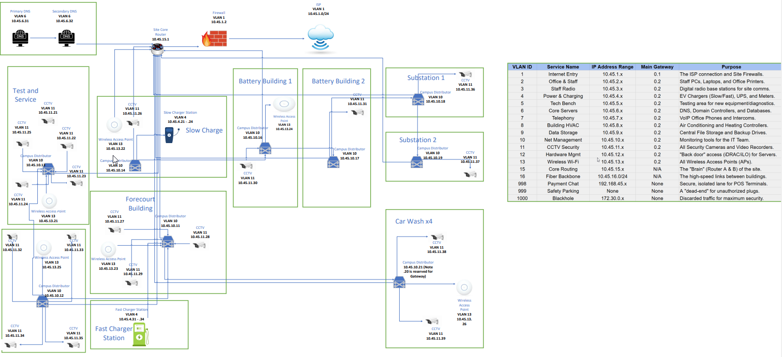
Logical Diagram of Site and Buildings

Slide 4
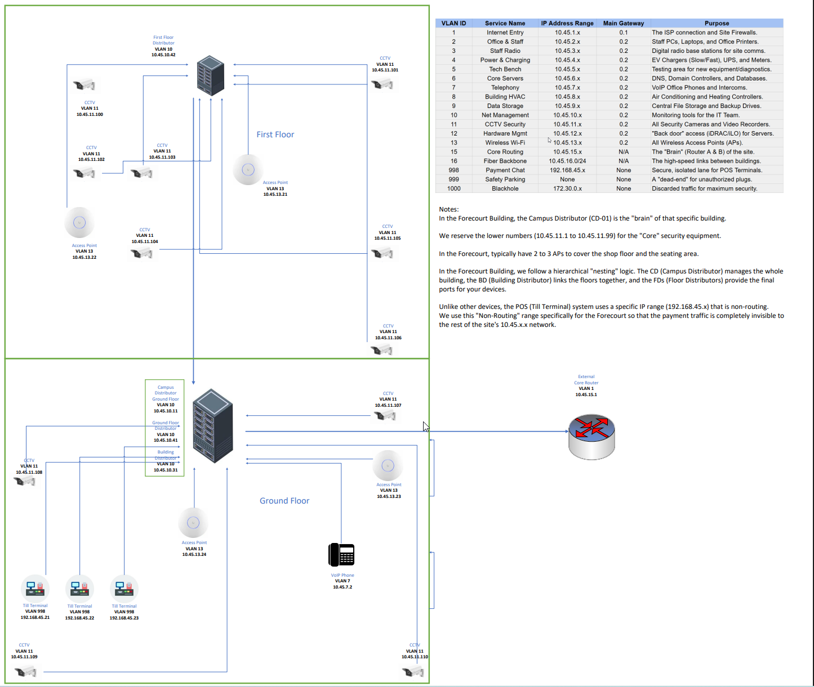
Logical Diagram of Forecourt Building

